Slide 1
Career Compass AI - AI powered employability
assessment and career readiness platform Using Resume
Analysis and Skill Gap Assessment
Department of Artificial Intelligence and Data Science
Presented By
Saravanan K (23AD045) – IV year
Mathan M (23AD024) – IV year
Logesh K (23AD023) – IV year
Kavutham M (23AD017) – IV year
P.S.R Engineering College, Sivakasi
Academic Year: 2026–2027
Project Guide: Mrs. V. Devi Nandhini Mam

Slide 2
Domain & Technology Stack
Primary Domain
Artificial Intelligence & Data Science
Technology Stack
Frontend
Backend
Database
NLP
Analytics
React.js
Python, FastAPI
PostgreSQL
spaCy, Transformers
Python
Major Sub-Domains
Natural Language Processing
Machine Learning
Resume and job description analysis
Matching and candidate scoring
Recommendation Systems
Data Analytics
Job and learning recommendations
Performance and readiness tracking

Slide 3

Abstract
PROBLEM STATEMENT
Students often apply for jobs without knowing whether their skills and resume fit specific roles. Existing systems mainly focus on parsing and keyword matching, without evaluating actual competency.
PROPOSED SOLUTION
Career Compass AI analyzes a student's resume against selected job roles or job descriptions. It evaluates resume quality, ATS compatibility, job match, missing skills, and improvement areas.
The platform also recommends projects, conducts role-specific mock assessments, tracks skill growth, and generates a personalized learning roadmap.
The system guides candidates toward job readiness.

Slide 4
Project Objectives
1. Resume Analysis
2. Job Match
Analyze resume structure, skills, education, projects, and experience.
Compare the candidate profile with selected job roles or descriptions.
3. Skill Gap Identification
4. Career Recommendations
Identify matching, missing, and weak skills.
Recommend suitable job roles, companies, and projects.
5. Mock Assessment
6. Skill Analytics
Generate role-specific assessments.
Track improvement across assessment attempts.
7. Personalized Roadmap
8. Readiness Score
Generate a learning roadmap based on performance and gaps.
Provide a job-specific employability score.

Slide 5

Literature Survey
Five foundational papers shaped this work, which extends prior systems with ATS scoring, job matching, skill-gap analysis, project recommendations, and skill improvement tracking.
Paper Title
Main Contribution
Gap
An Intelligent Resume Analysis and Job Recommendation System Using NLP (2026)
Resume parsing and job recommendation
No competency validation
Job Description Parsing with Explainable Transformer Models (2024)
JD parsing and skill extraction
JD-focused only
Smart-Hiring: End-to-End CV Information Extraction and Job Matching (2025)
CV extraction and job matching
No personalized skill-development cycle
AI-Powered Semantic Resume & Skill-Gap Analyzer (2025)
Semantic matching and skill-gap detection
Limited progress tracking
Resume Analysis Using NLP and ATS Algorithm (2025)
ATS scoring and resume evaluation
No assessment-driven roadmap
Research Gap: Existing systems address resume analysis, job matching, or skill-gap detection separately. An integrated cycle for assessment, tracking, and personalized career development remains limited.

Slide 6
Summary of Literature Survey
Existing Research Coverage
Our Proposed Contribution
Most approaches focus on:
Integrated workflow
Resume processing and parsing
Job description analysis
Resume–job matching
Skill gap identification
Recommendation systems
Resume processing & Readiness scoring
Job description analysis
Resume–job matching
Skill gap analysis & Project recommendations
Assessment-driven recommendations
Limitations
No integrated assessment pipeline
Limited personalized development tracking
Few systems connect analysis to actionable improvement

Slide 7
Existing System vs Proposed System
Existing Systems
Career Compass AI
Resume-based analysis
Resume + job requirements analysis
Keyword matching
Semantic matching and scoring
Generic recommendations
Role-specific recommendations
No skill progress tracking
Skill improvement analytics
No practical validation
AI mock assessment and roadmap
Evaluates candidates using resume information only
Evaluates candidates using resume, job requirements,
assessment results, and skill progress

Slide 8
Proposed System Architecture
Vertical system flow showing how the platform moves from resume intake to role matching, project recommendations, assessment, analytics, and final readiness scoring.
User / Student - Uploads resume and enters the target job description.
Resume Analysis - Extracts ATS score, resume quality, and core profile strengths.
Resume vs Job Analysis - Compares matching skills and identifies missing skills.
Job/Company Match & Role Prediction - Predicts the best-fit role and company match score.
Recommended Projects - Suggests skill-based projects to strengthen weak areas.
AI Mock Assessment - Evaluates role-specific skills through an adaptive assessment.
Skill Performance & Progress Analytics - Tracks performance trends and improvement over time.
Personalized Learning Roadmap - Generates priority-based learning actions and next steps.
Job/Company Readiness Score - Outputs final readiness for the target job and company.

Slide 9
Modules of Career Compass AI
Module 1 — Resume Analysis
Module 2 — Job Role / JD Analysis
Resume parsing
ATS assessment
Quality scoring
Requirement extraction
Skill identification
Resume–JD match scoring
Module 3 — Skill Gap & Recommendation
Module 4 — AI Mock Assessment
Skill gap detection
Job role prediction
Project recommendations
Role-specific questions
Skill evaluation
Feedback scoring
Module 5 — Skill Analytics
Module 6 — Personalized Roadmap
Assessment tracking
Score comparison
Progress trends
Skill development plan
Learning resources
Milestone tracking
Module 7 — Company & Career Readiness
Company Readiness
Job Role Suitability
Company
Score
Job Role
Suitability
Infosys
91%
Backend Developer
92%
TCS
89%
Java Developer
88%
Zoho
72%
Full Stack Developer
81%
Amazon
58%
AI Engineer
60%
Google
41%

Slide 10
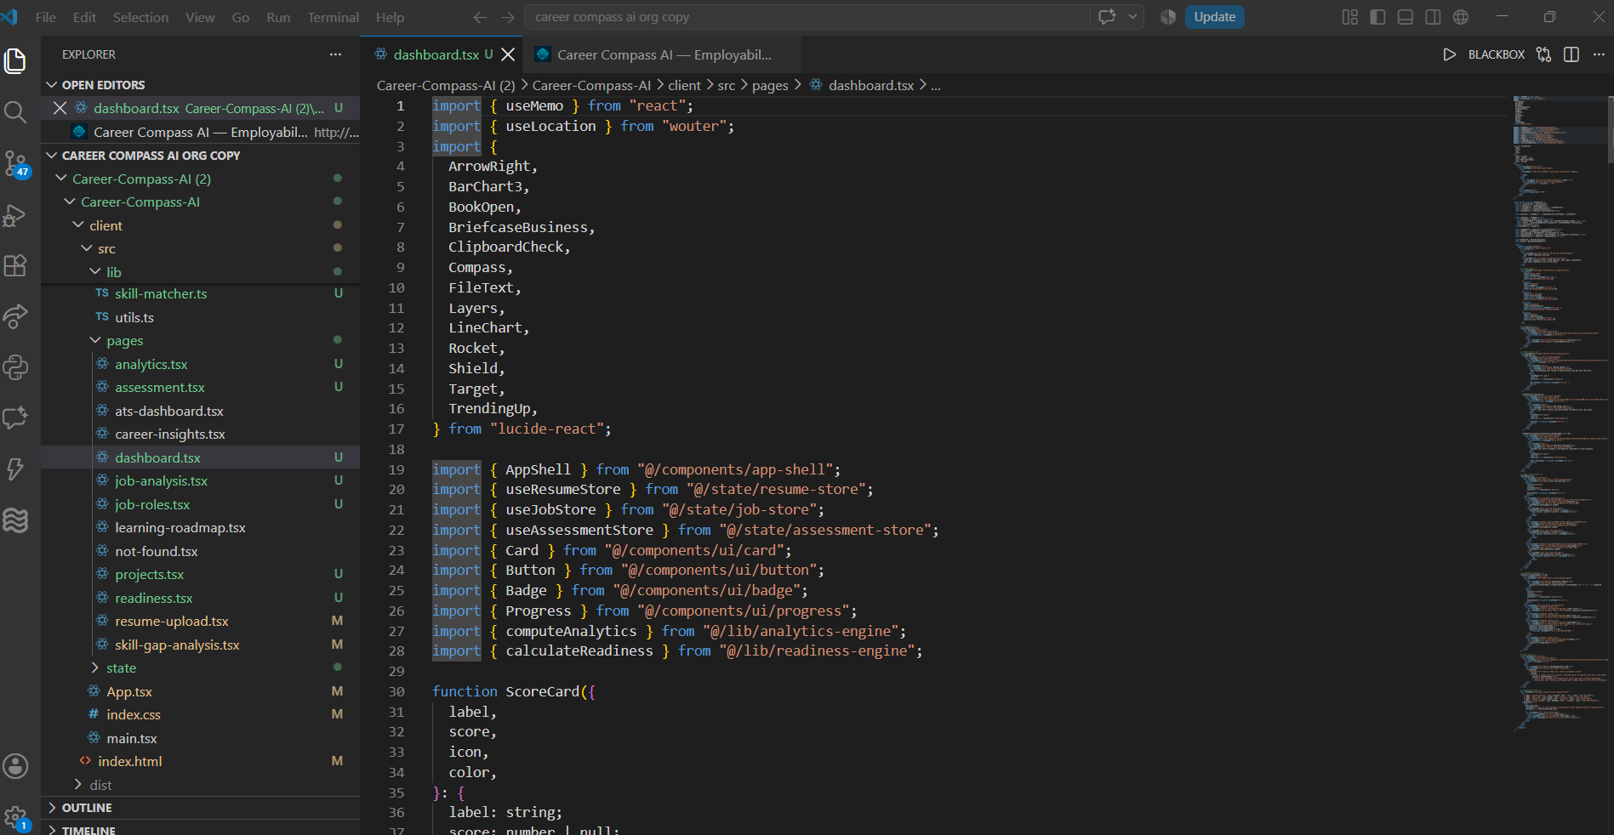
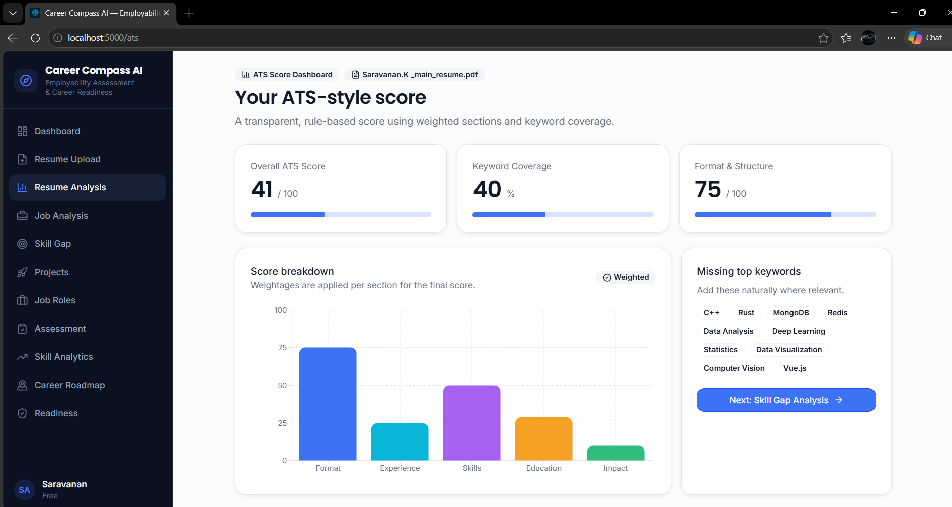
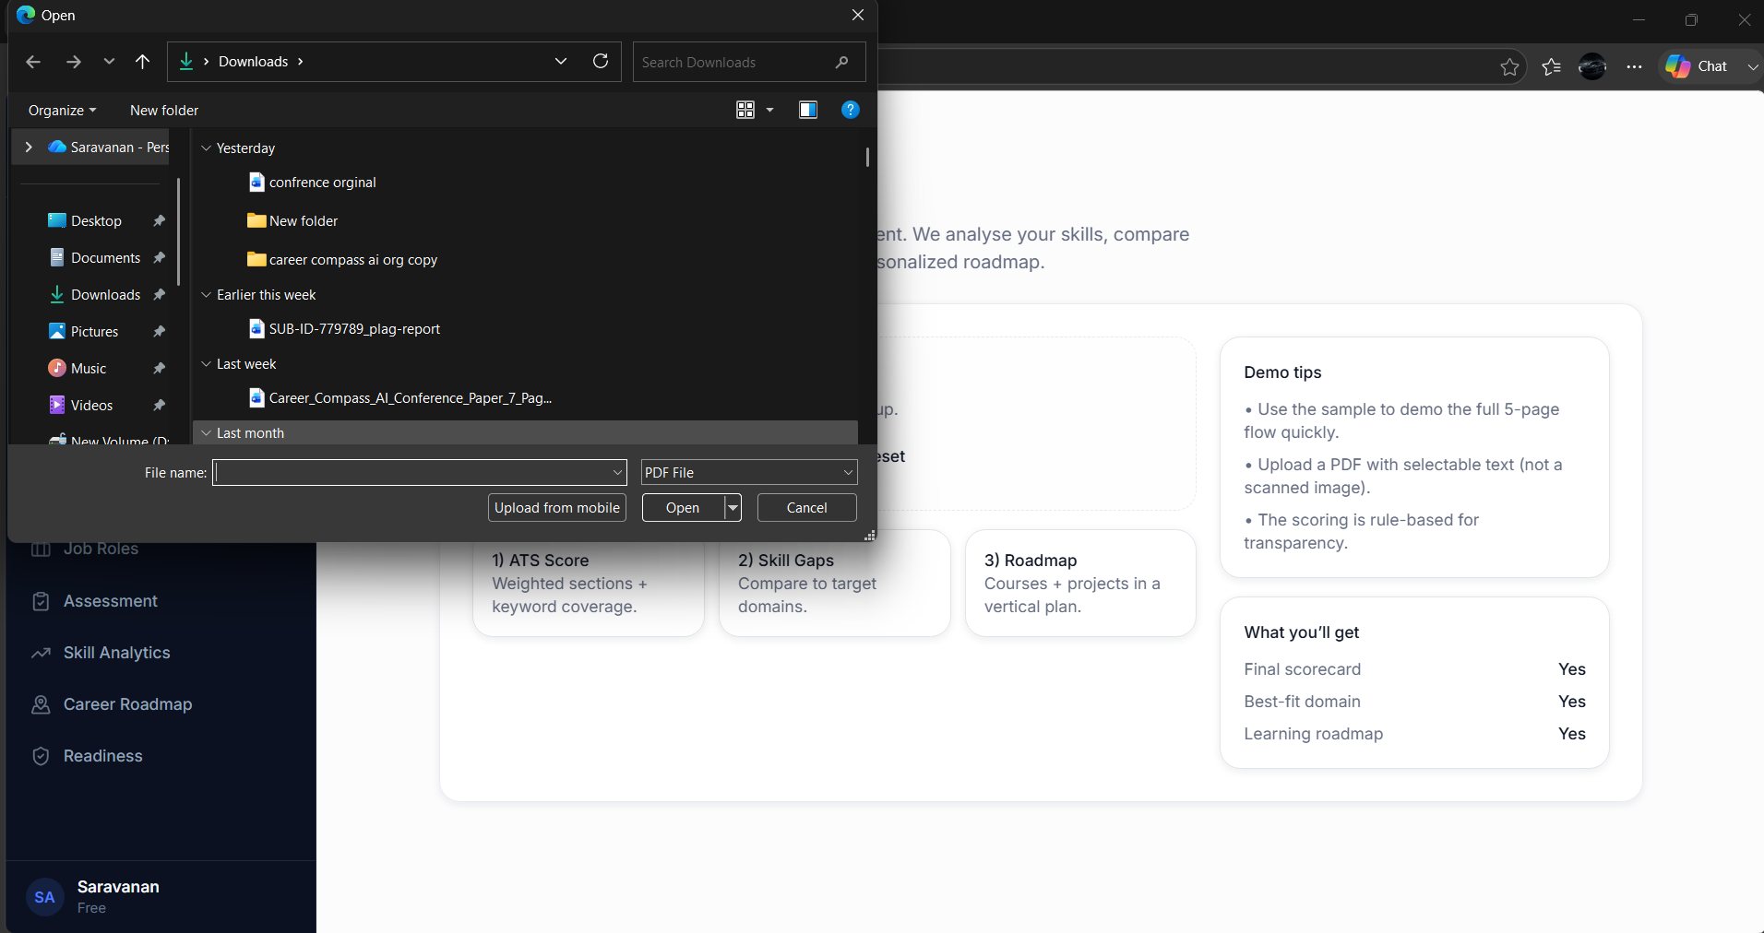
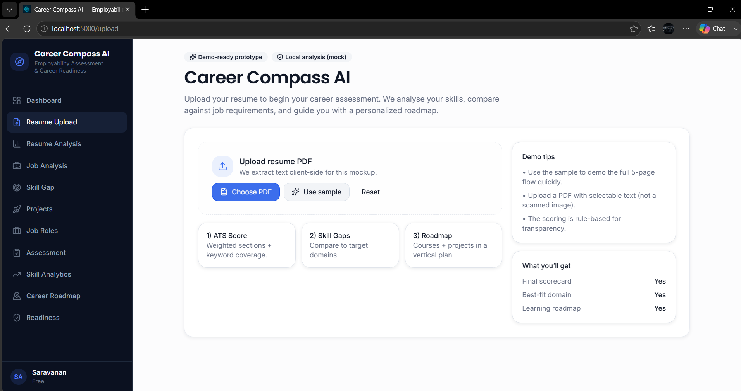
Module

Slide 11
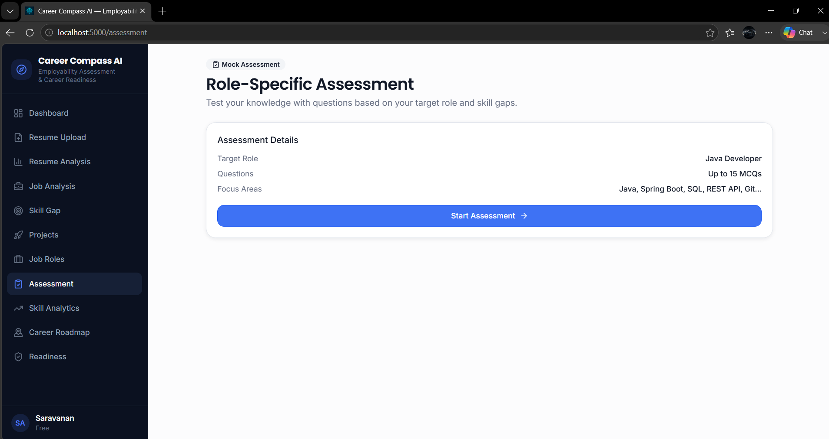
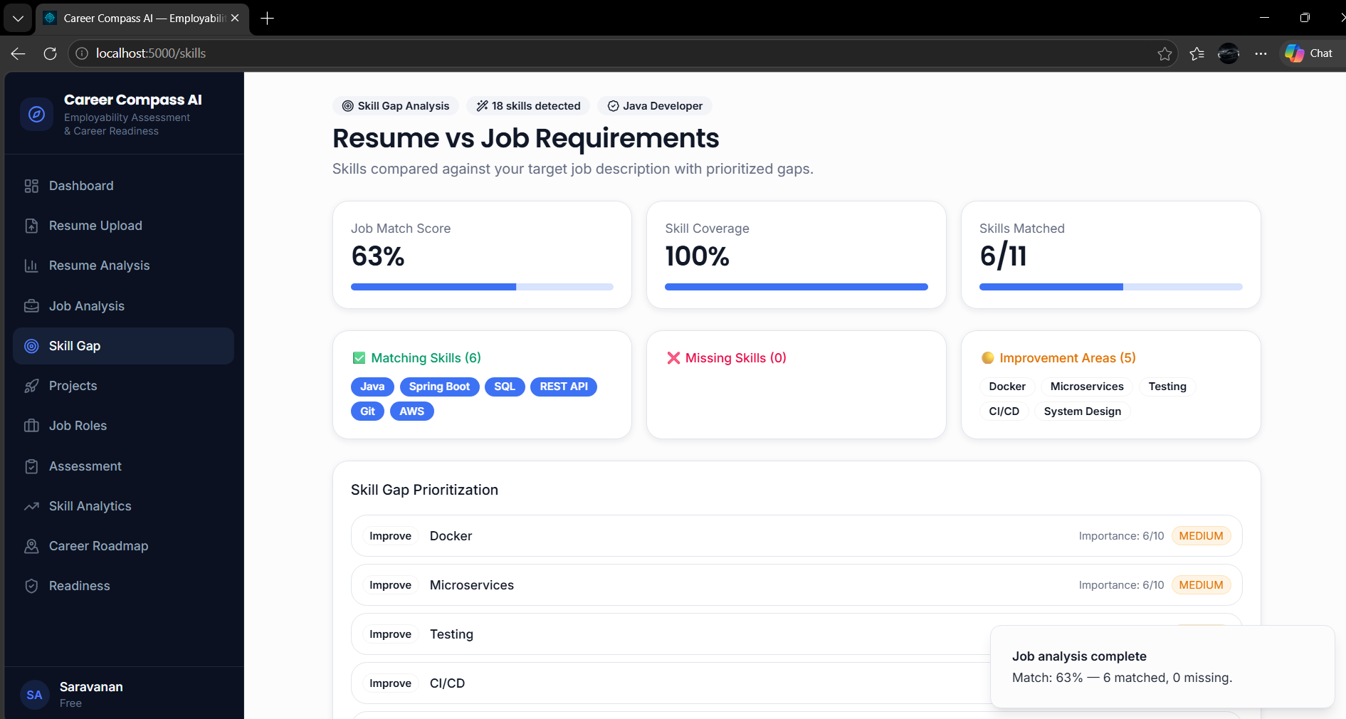
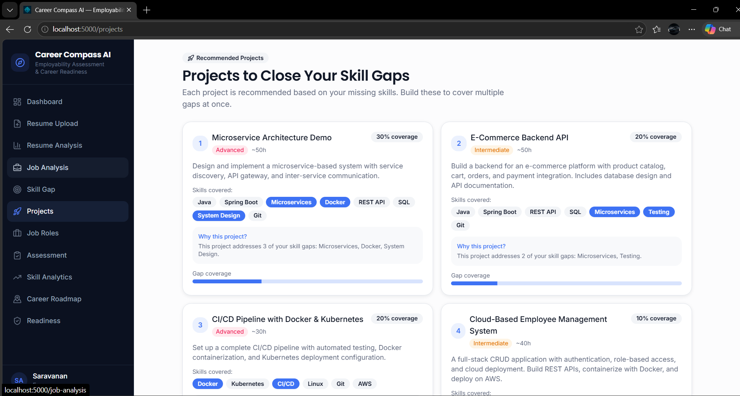
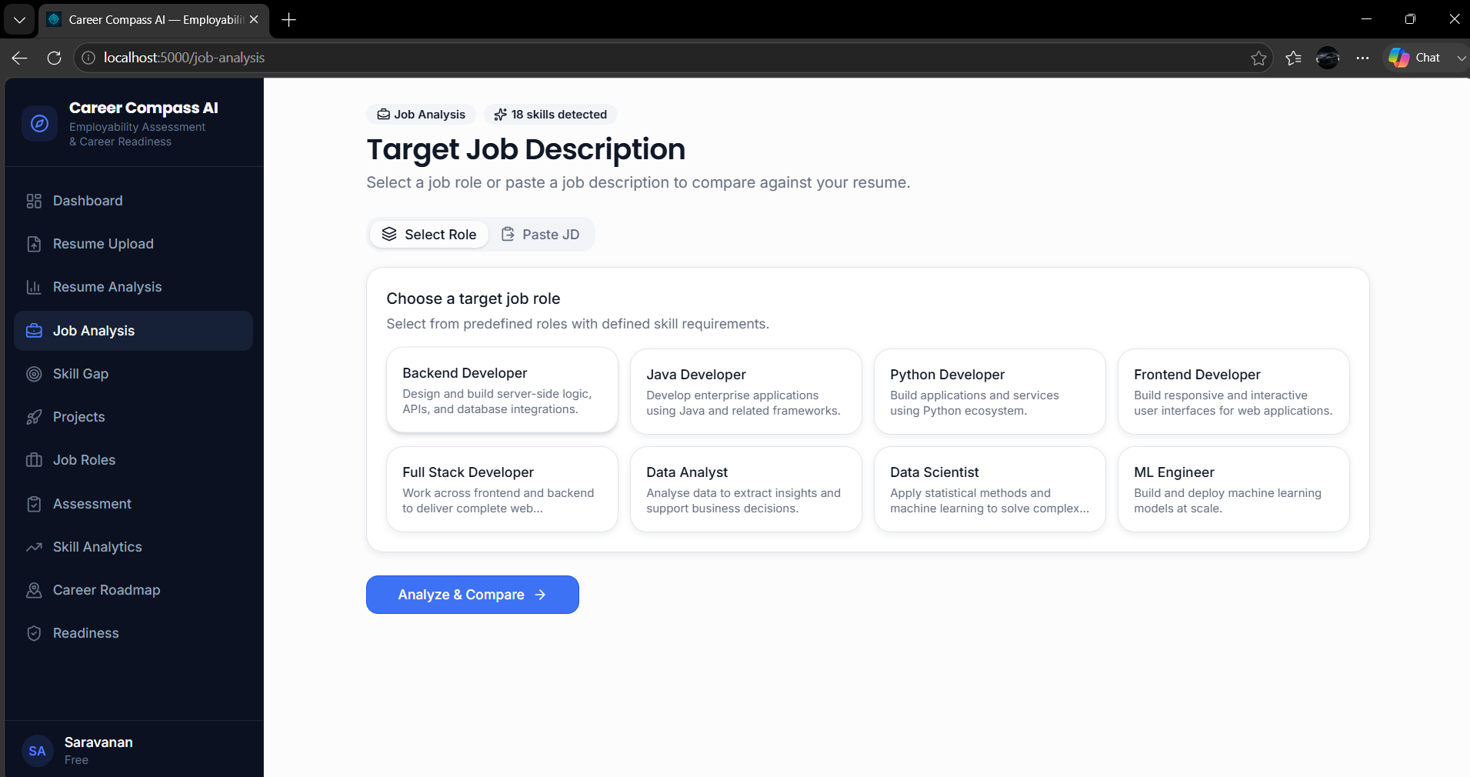

Slide 12
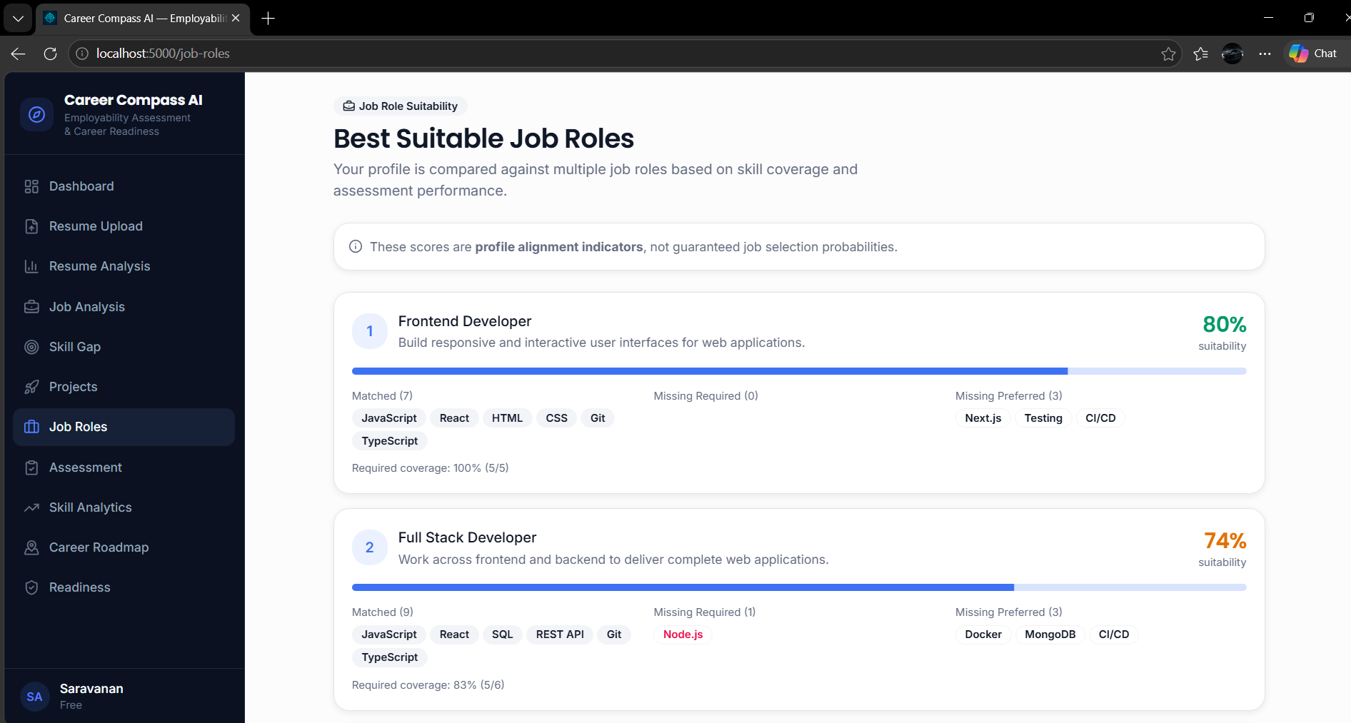

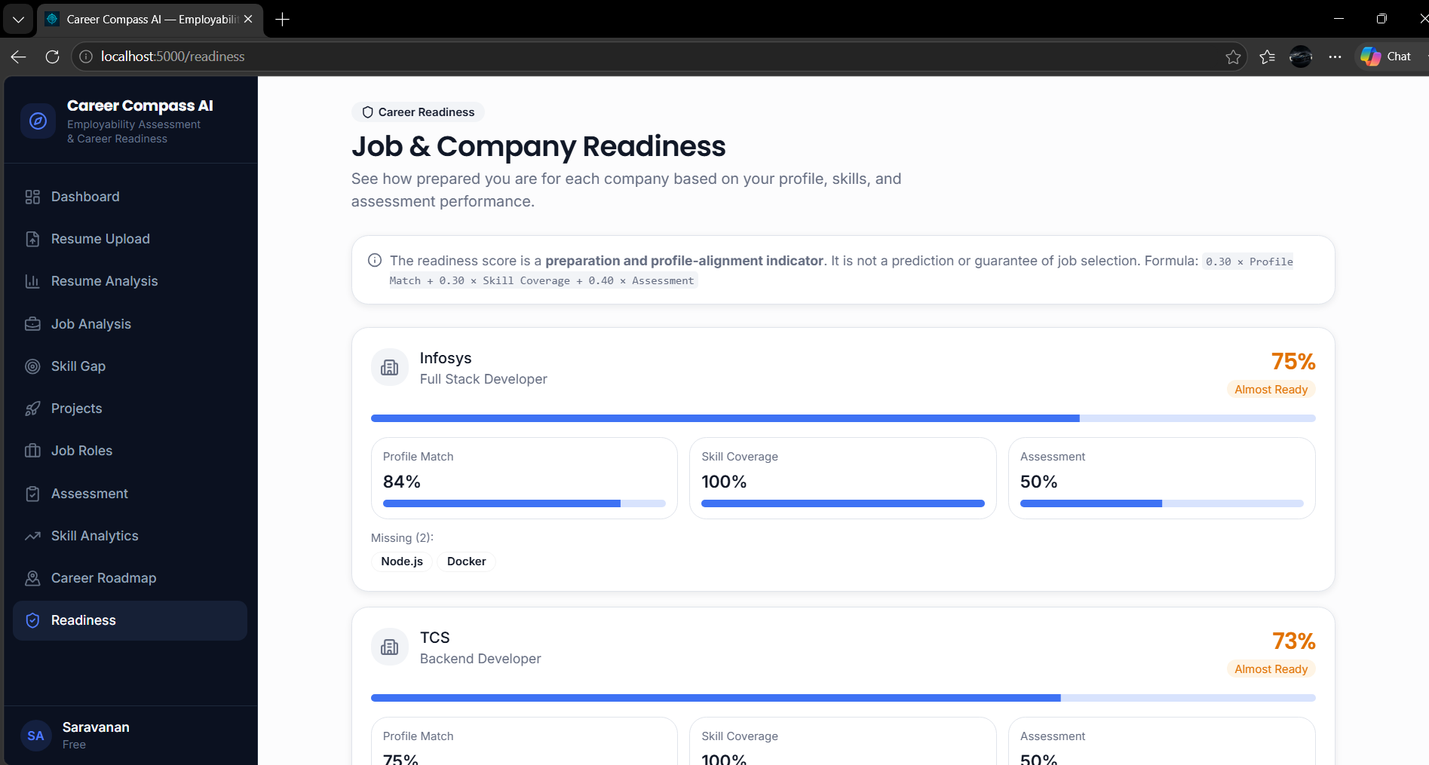

Slide 13
